Slide 1
SMPL: Skinned Multi-Person Linear Model
http://files.is.tue.mpg.de/black/papers/SMPL2015.pdf

Slide 2
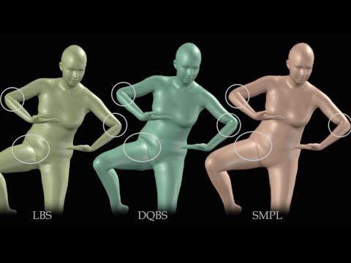

Slide 3
What is SMPL
Parametric human body model that can represent different body shapes, deform naturally with pose, and exhibit soft-tissue motions like those of real humans.
72 pose parameters and 16 shape parameters that are used to modify a template mesh from a rest pose. Pose & shape parameters are independent.
Vertex displacement based model as opposed to SCAPE which is a triangle deformation model.
Blend skinning is used to deform the human body according to pose making it efficient to animate and compatible with existing rendering engines.
Simple formulation that enables training the entire model from a relatively large number of aligned 3D meshes of different people in different poses

Slide 4
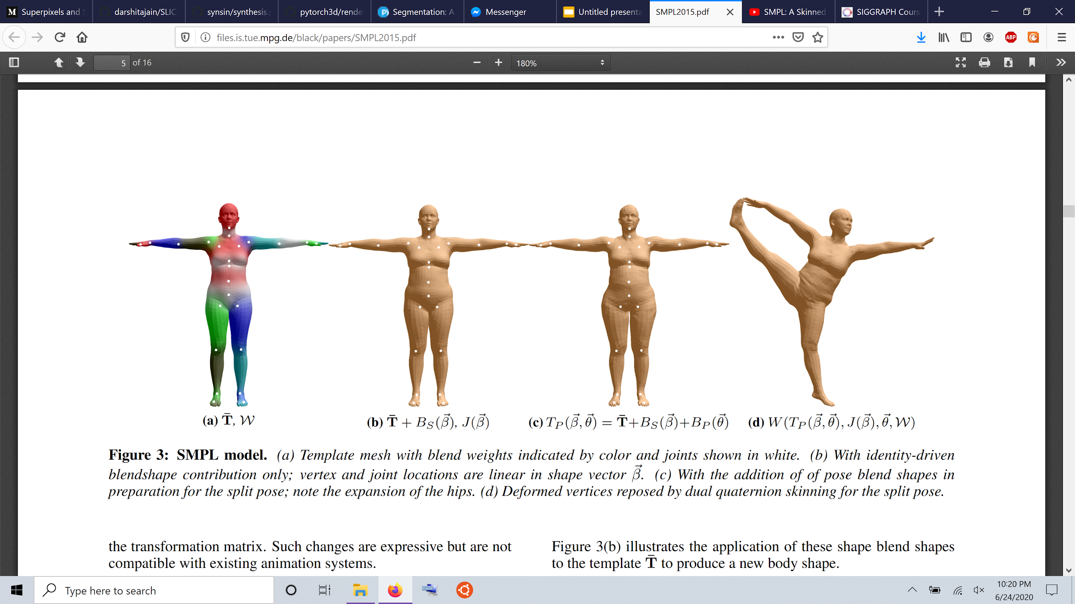
Pipeline
Template Mesh
Shape
Blend Shapes
Pose
Blend Shapes
Final Mesh

Slide 5
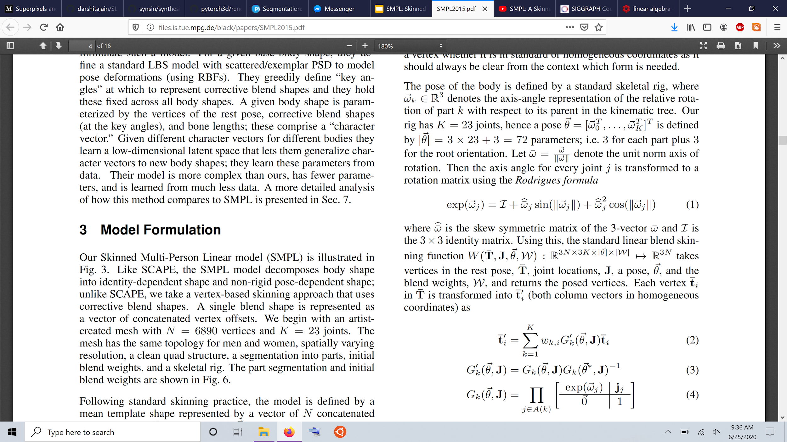
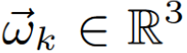
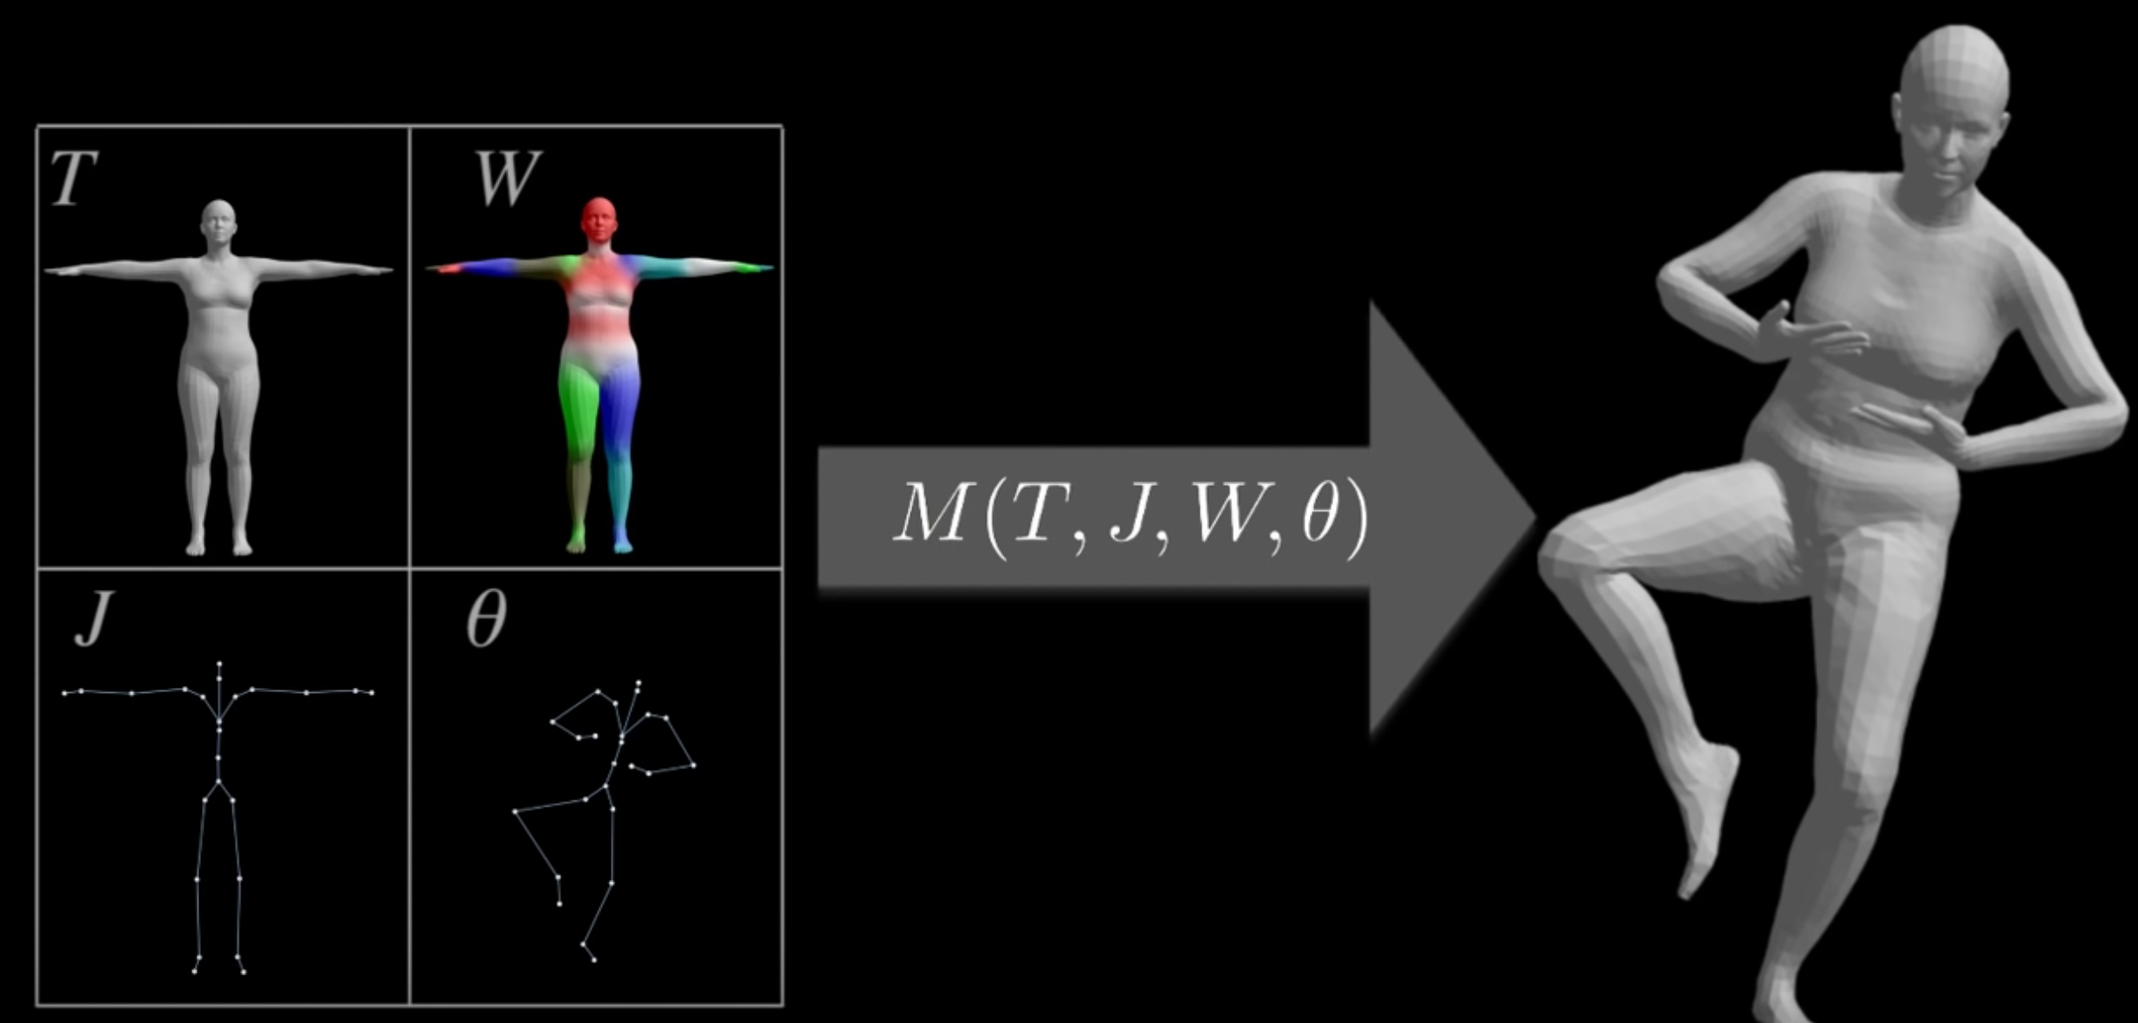
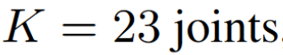
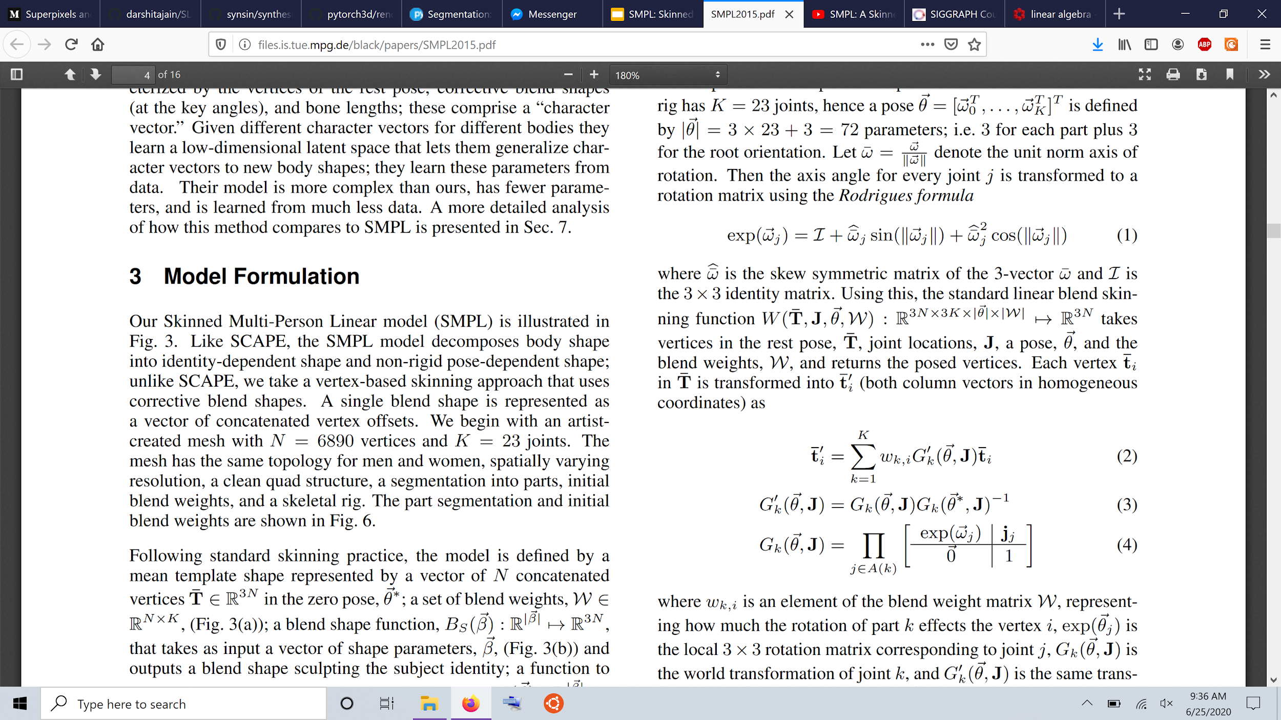
Blend Skinning

Slide 6
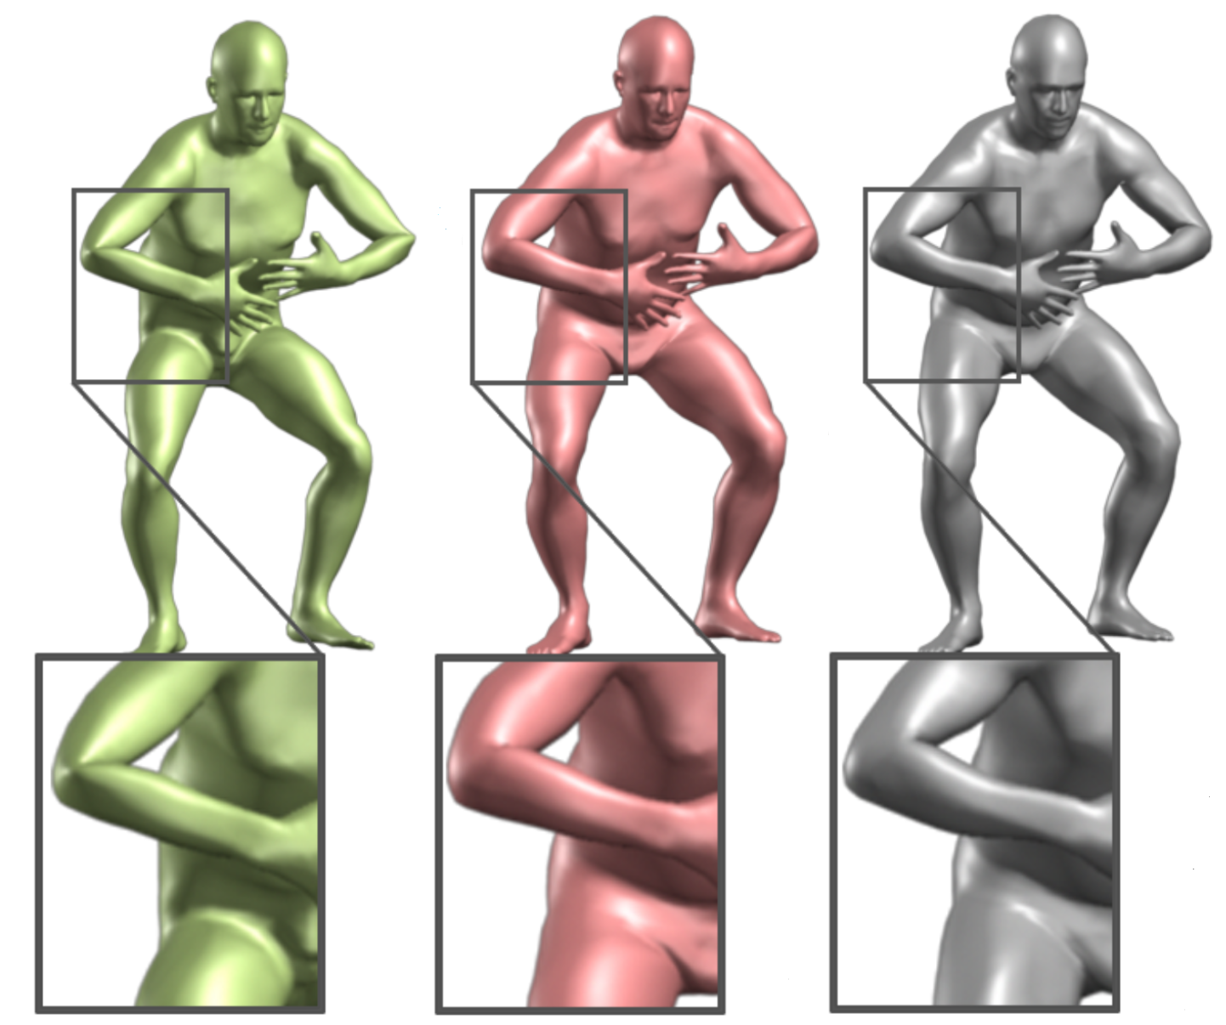
Problems with LBS
LBS
SMPL +LBS
Registered Mesh

Slide 7
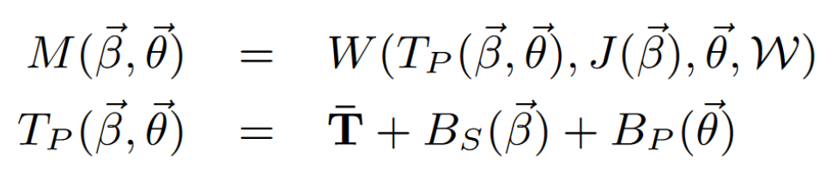
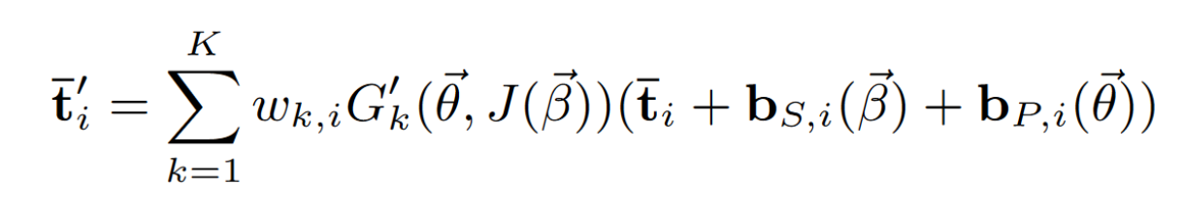
Blend Skinning

Slide 8
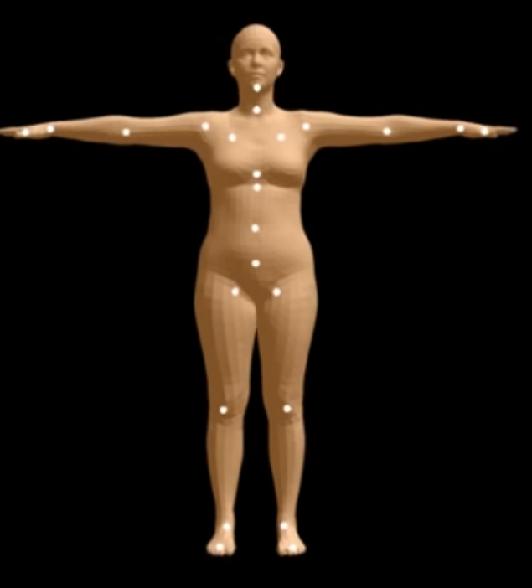
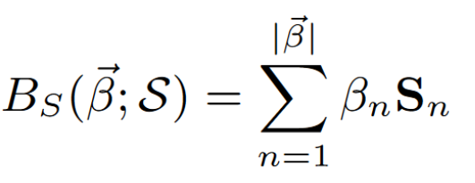
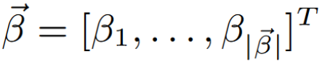
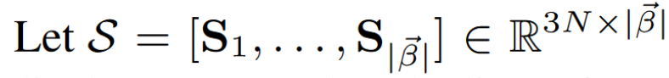
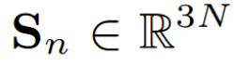
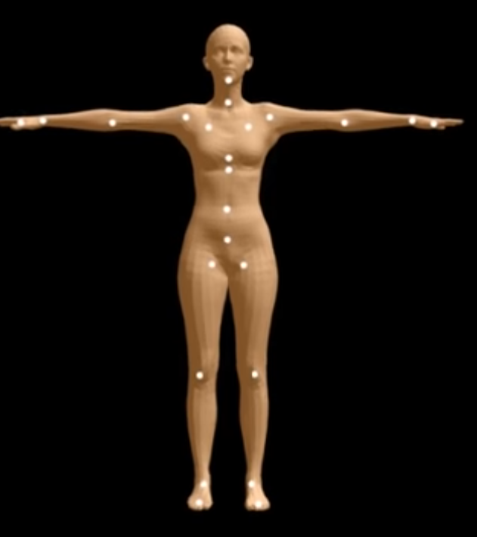
Shape Blend Shapes
S is the matrix of orthonormal principal components of shape displacements

Slide 9
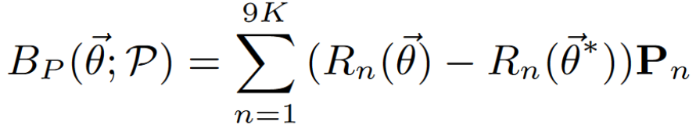
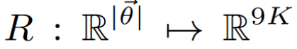
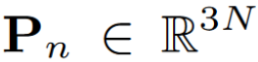
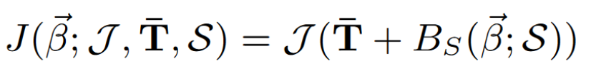
Pose Blend Shapes
P is the matrix of 207 different pose displacements
Joint Regressor:

Slide 10
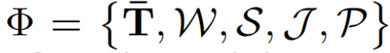
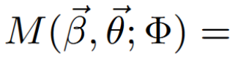
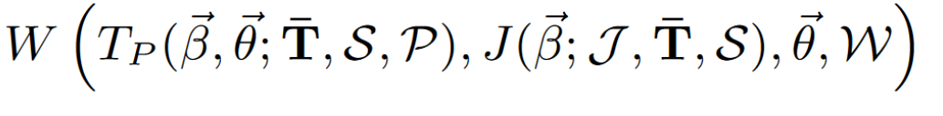
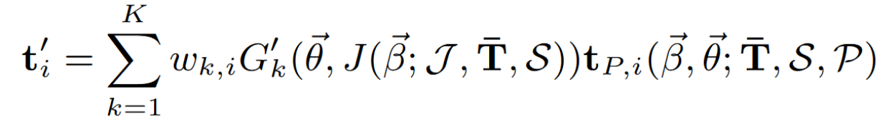
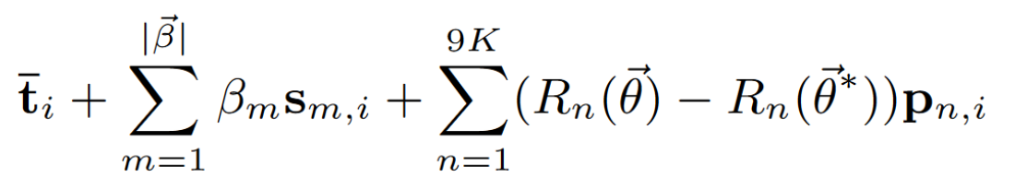
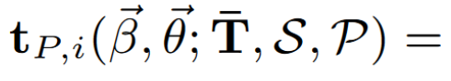
Putting it together

Slide 11
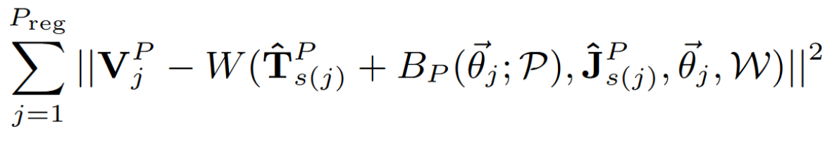
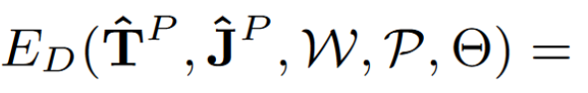
Pose Parameter Training
First train for Joint Regressor, Blend Weights and Pose Blend Shapes parameters
Trained on multi-pose dataset consisting of 1786 registered meshes of 40 individuals
Loss consists of 1 data term and 4 regularization terms
Data term:

Slide 12
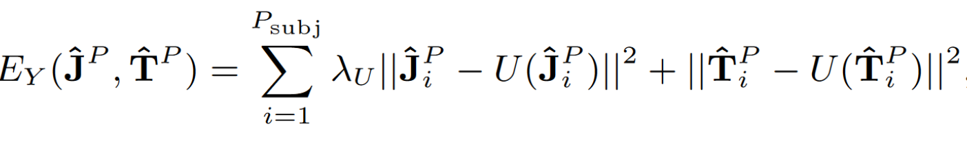
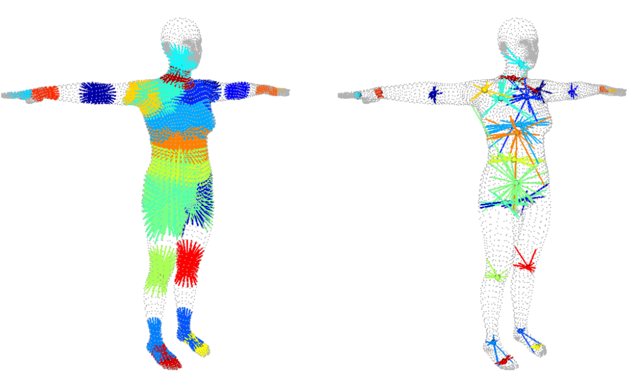
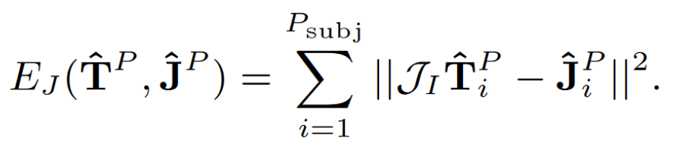
Pose Parameter Training
Symmetry regularization term:
Joint Regressor regularization term:

Slide 13
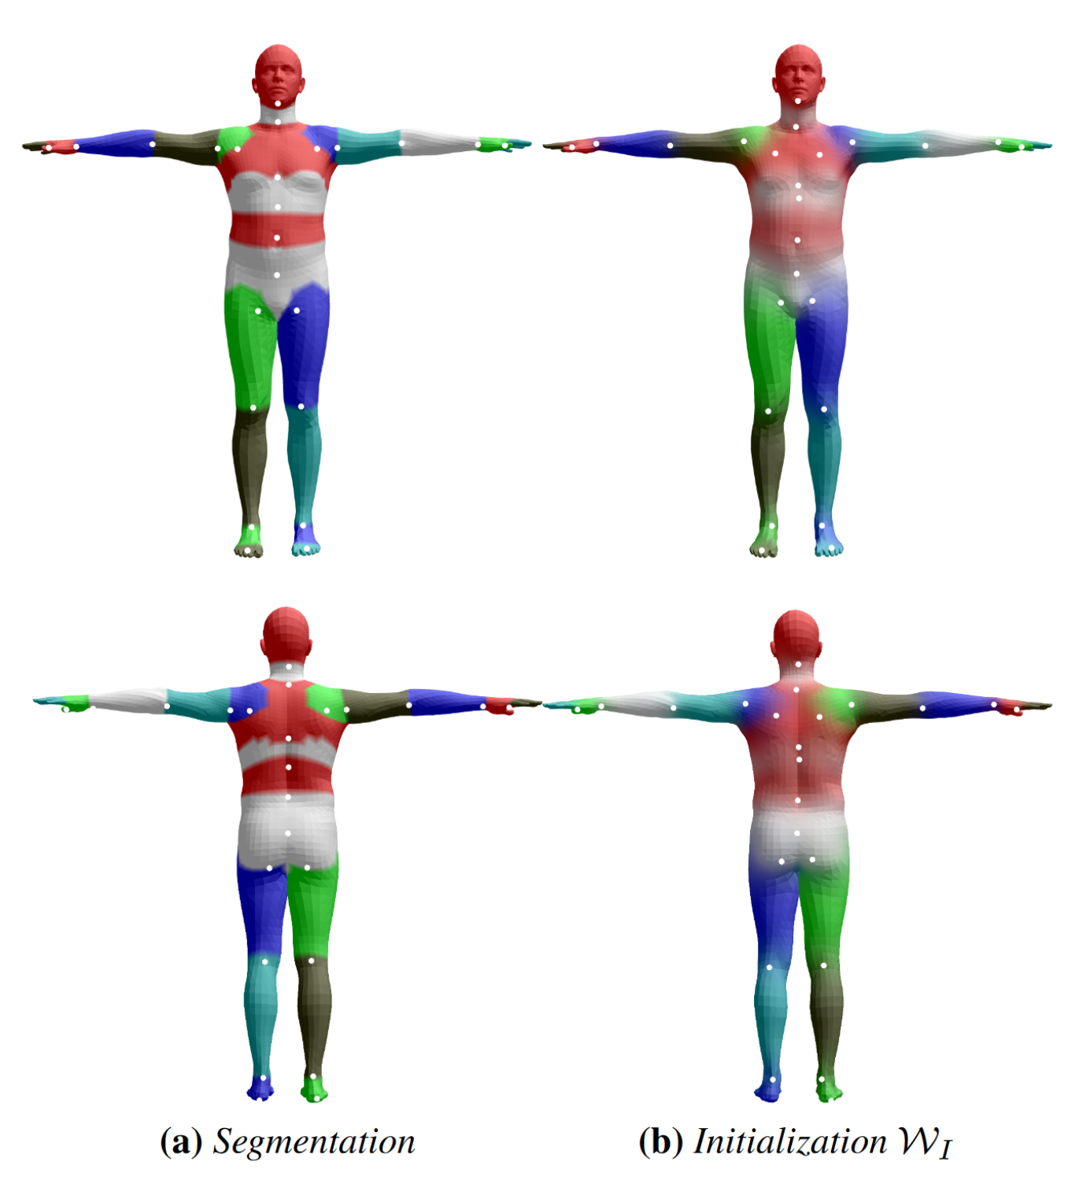
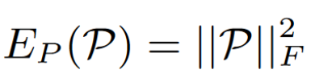
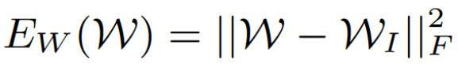
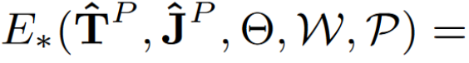
Pose Parameter Training
Pose blend shapes regularization term:
Blend Weights regularization term:

Slide 14
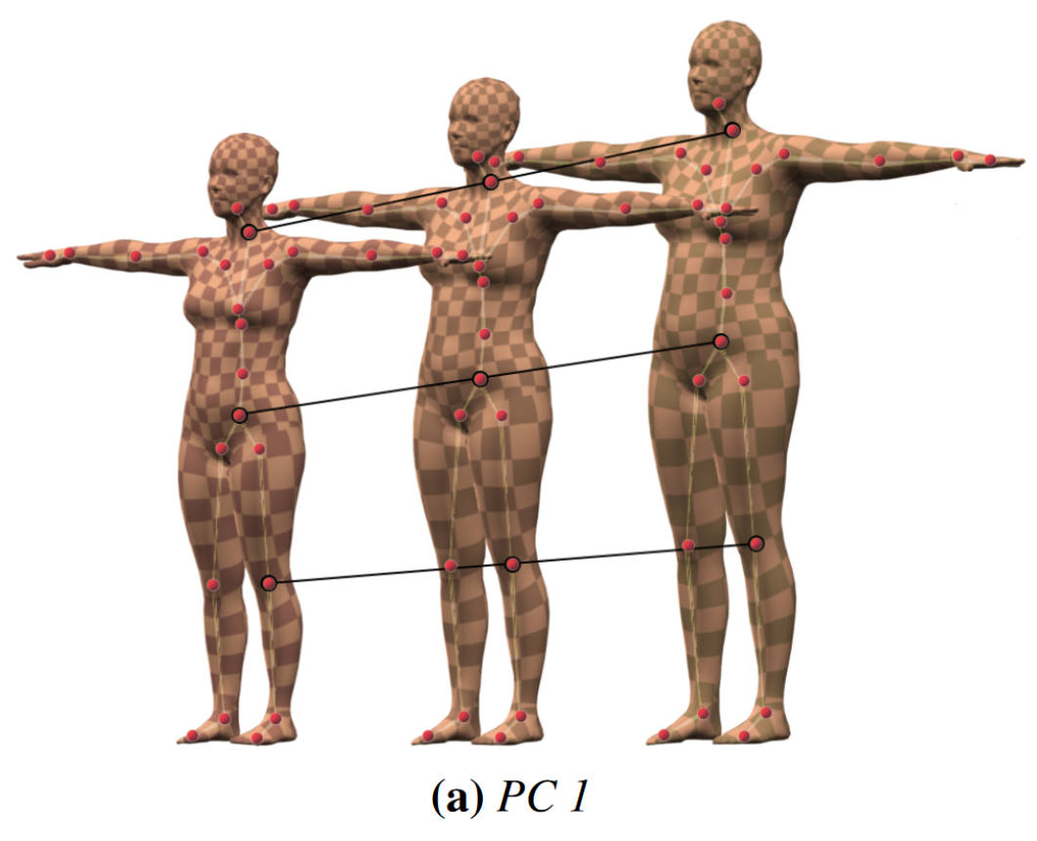
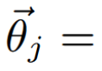
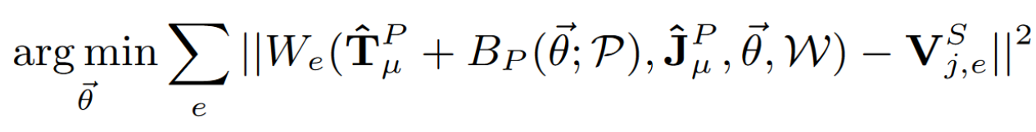
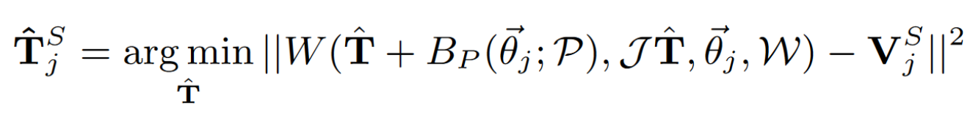
Shape Parameter Training
Train for Template mesh and Shape Blend Shapes.
Computed by PCA on pose normalized registered meshes
Trained on CAESAR dataset with 3800 registered meshes
Pose Normalization:

